Slide 1
Coursera Capstone Project
Sanya Srivastava

Slide 2
BUSINESS PROBLEM
Location of Steakhouse can determine its success or failure as a restaurant
In the city of Sydney, Australia, if a steakhouse restaurant owner wants to open a restaurant, where would you recommend opening it?

Slide 3
DATA
To solve the problem, we will need the following data:
List of neighborhoods in Sydney, Australia.
Longitude and latitude coordinates of the neighborhoods.
Venue data
Source of data and methods to extract them
The Wikipedia page (https://en.wikipedia.org/wiki/Category:Suburbs_of_Sydney) contains a list of neighborhoods in Sydney, Australia with 200 neighborhoods.

Slide 4
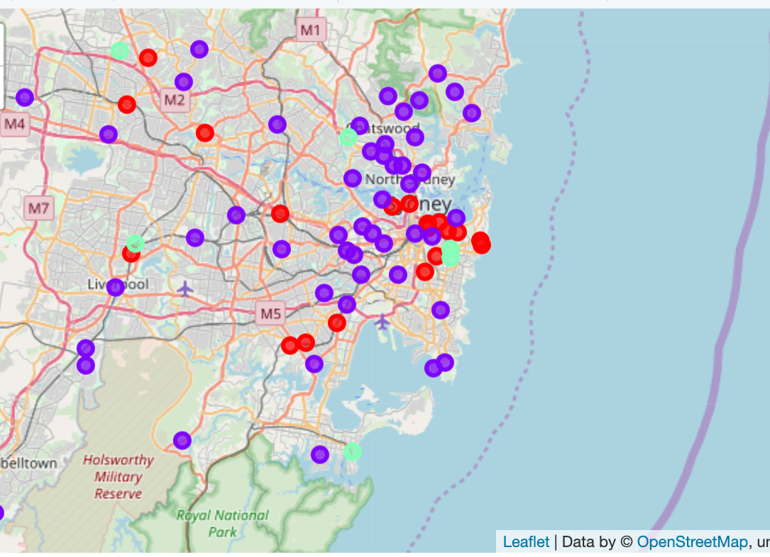
RESULTS
The results for the k-means clustering algorithm on the “Steakhouses” in Sydney, Australia shows three clusters based on this specific venue frequency:
Cluster 0: Low number of steakhouses.
Cluster 1: Low number of steakhouses
Cluster 2: High number of steakhouses
Below us a folium map that shows the cluster of steakhouses in neighborhoods.

Slide 5
CONCLUSION
I found that clusters 1 and 0 should have the next steakhouse to profit and be successful in Sydney, Australia.
This project focuses on building a new steakhouse restaurant in Sydney, Australia to expand the beef market in Australia.

